Slide 1

Climate downscaling and impact assessment
Larger picture of climate data applications
Yinpeng LI
International Global Change Institute, New Zealand

Slide 2
Towards full spectrum weather and climate services(GFCS)
Decades
Scenarios
Years
Uncertainty
Outlook
Seasons
Guidance
Months
Threats Assessments
2 Week
GCMs (CMIP5)
Forecast Lead Time
1 Week
Global Forecast System
(CFSv2, ECMWF)
Downscaling and statistical modeling
Forecasts
Days
Watches
Hours
Warnings & Alert Coordination
MetSevice, MetOcean technologies
Minutes
Benefits
Maritime
Health
Aviation
Agriculture
Adaptation
Commerce
Recreation
Ecosystem
Infrastructure
Life & Property
Fire Weather
Hydropower
Environment
Space Operations
Emergency Mgmt
Energy Planning
Reservoir Control
Notes:
MME Prediction Systems are increasingly used across time scales in the NCEP Model Production Suite

Slide 3
User groups are hungry for data
(big meal vs fast food)
Academic and research program
Sectoral assessment: health, energy, transport, food
National, regional, and urban planning
Capacity building projects
Consultancy firms: local planning
Infrastructure projects: water supply, drainage system, transportation, stadium.

Slide 4
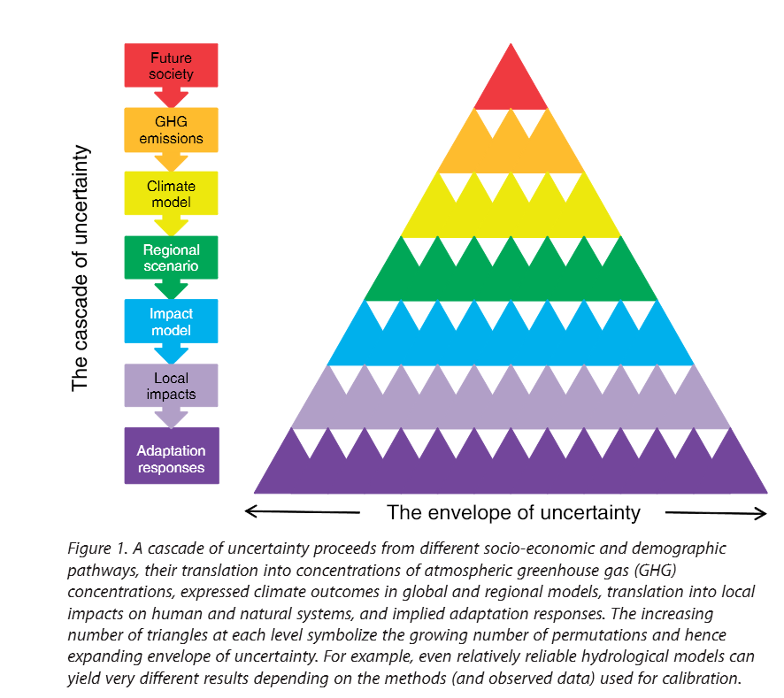
Climate change projection Uncertainty Cascade
and data requirement
The data needs to be:
Legitimate (authorized)
Credible (reliable sources)
Plausible (compatible format)
Actionable
(practical, applicable for impact analysis)

Slide 5
Development ladder of adaptation from concept to good practice
Human knowledge and capacity
Good practice
Public engagement and application
Best effort
Practice
Data and tool library building
Tools and data
Experiment and trial
Capacity building and mainstreaming
Theory framework
Concepts and ideas
Problem and risks
Time

Slide 6
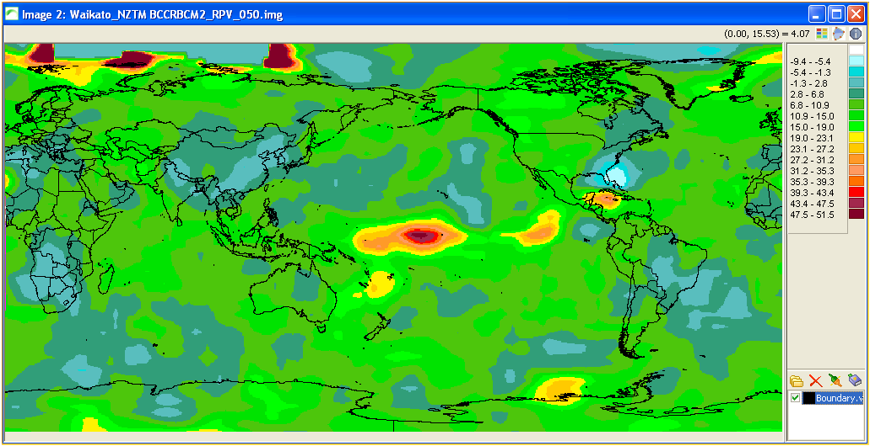
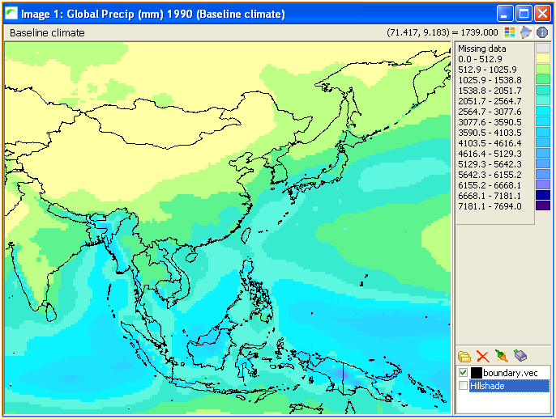
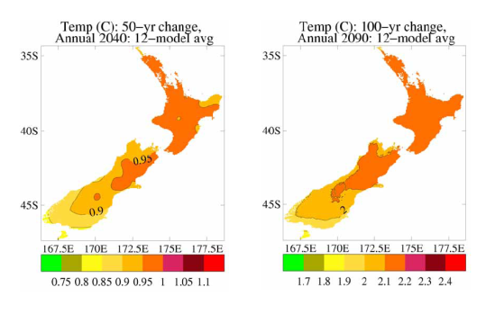
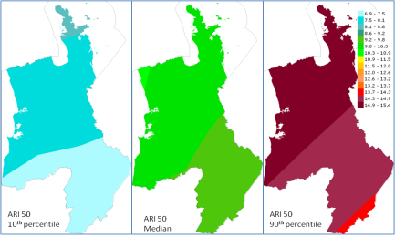
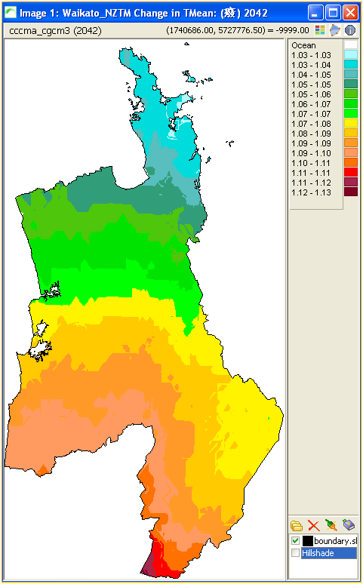
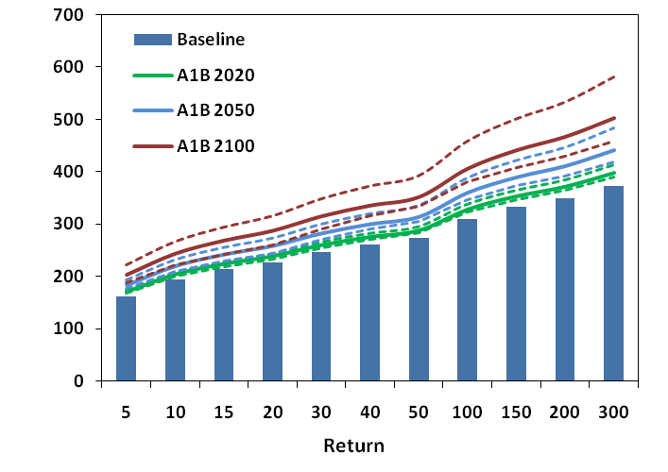
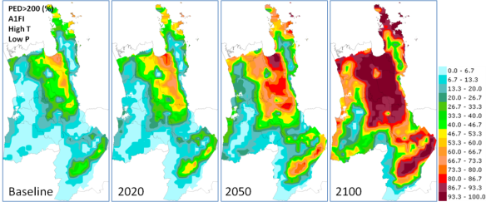
Downscaling, patterns scaling and impact assessment
Statistical downscaling
GCM
RCM
Pattern scaling,
Interpolation
Bias corrected transient time series
SD + Pattern scaling,
Interpolation
Impact assessment
Extreme precipitation
Drought risk
Impact assessment
Observed precipitation and temperature, …

Slide 7
SimCLIM climate change library method
IPCC AR4, AR5
GCM atmos. and ocean raw data
OCIMP AR5
Ocean model BGC raw data
Other model data
Patterns scaling, statistical and dynamic downscaling(RCM), data evaluation
Normalized patterns
Transient data
Performance indicators
Other climate scenario libraries
CORDEX (RIMP)
SimCLIM
climate change library
SimCLIM climate change scenario and observation data management tool
Observation data
Notes:
COordinated Regional climate Downscaling EXperiment (CORDEX)
OCIMP AR5: Ocean Carbon Model Intercomparison Program
RCSL: Regional Climate Scenario Library, ADB

Slide 8

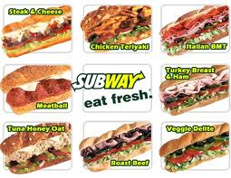
Ready to go information
Climate change signal (increase or decrease)
Highest risk level
Ensemble
Visualization
Suit to non hydro-met modellers
Policy makers and resource managers
Need training and ICT specialists

Slide 9
An ideal knowledge management system
Hands-on Software
Climate data library
Web applications
Data management
Downscaled climate change projections
Interactive data query and download
Data statistics and analysis
Spatial and time series data derived from observation
Impact assessment outputs visualization
Impact assessment
GIS data for impact assessment models
User space for upload data and forum
Visualization
Other data for national and local applications
Documentation and training materials
Universal Data Server
(data format conversion and adoption)

Slide 10
Project examples
Tajikistan capacity building project (ADB)
Mekong River Commission data provision
Qatar FIFA World Cup stadium design
UrbanCLIM/GENIES

Slide 11
Provide climate information to multiple users for Tajikistan (PPCR)
Establishment of a Climate Modelling Facility
Hardware and support personnel
Development of Climate Downscaling:
Dynamical downscaling, training and software
Statistical downscaling
Development of impact assessments for priority sectors and a climate risk screening tool
Existing tools (SimCLIM and GENIES) and development plan
Establish a climate data management system (web and hands on)
Develop climate science modules for education curricula

Slide 12
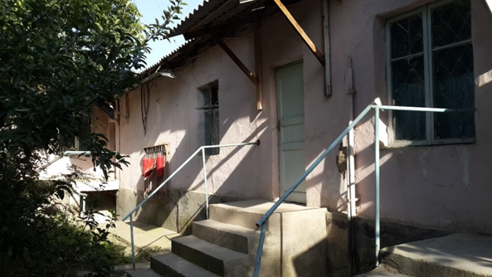
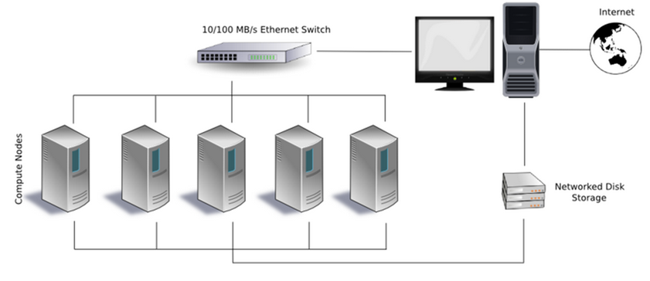
Climate modelling facility

Slide 13
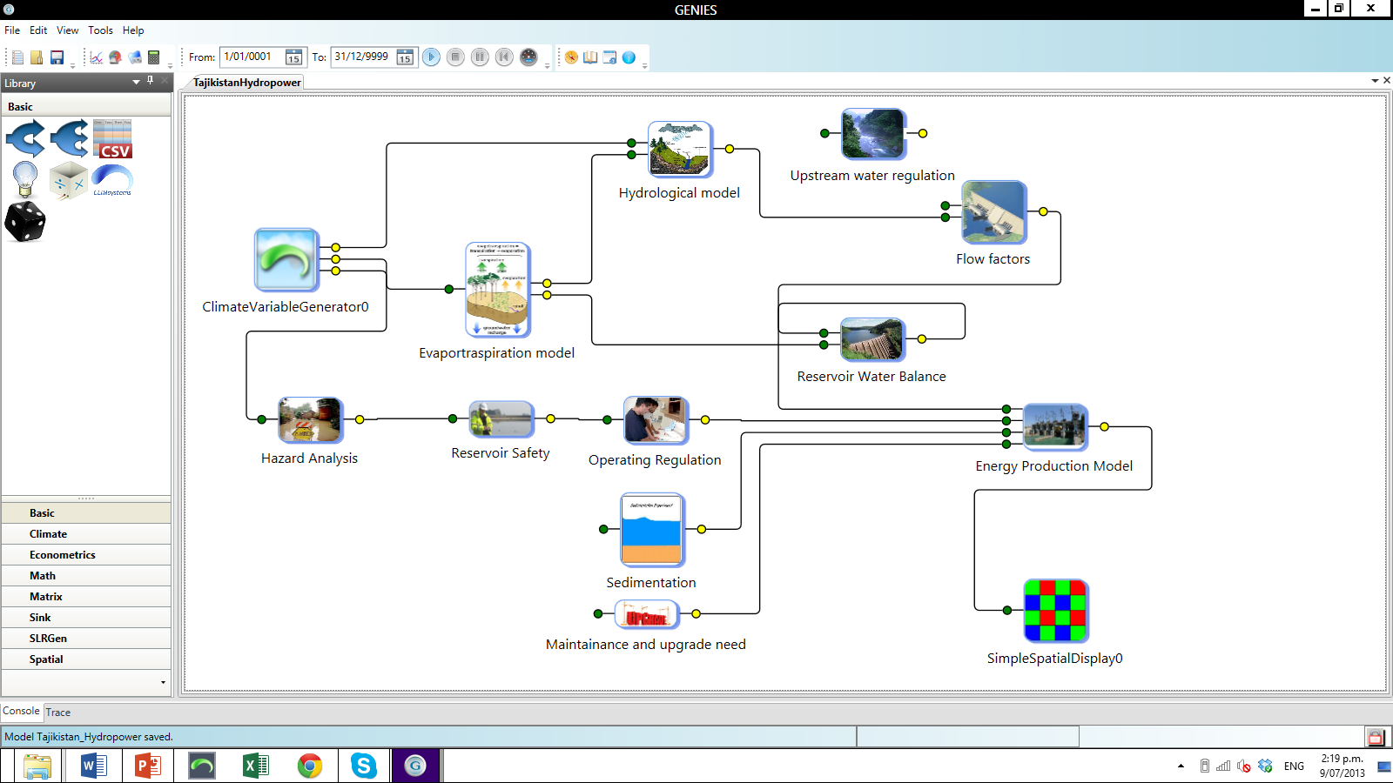
Tajikistan hydro power assessment model (concept)

Slide 14
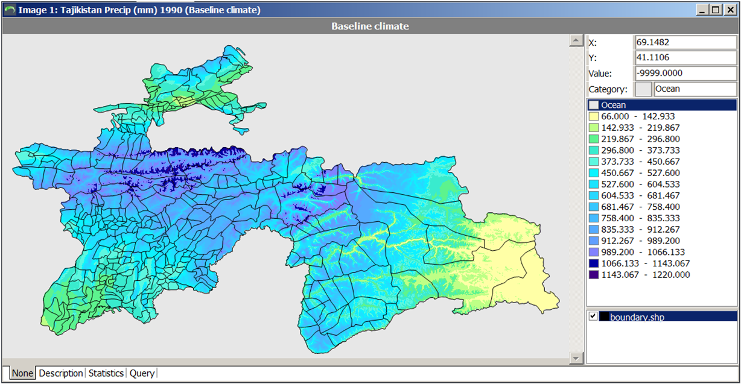
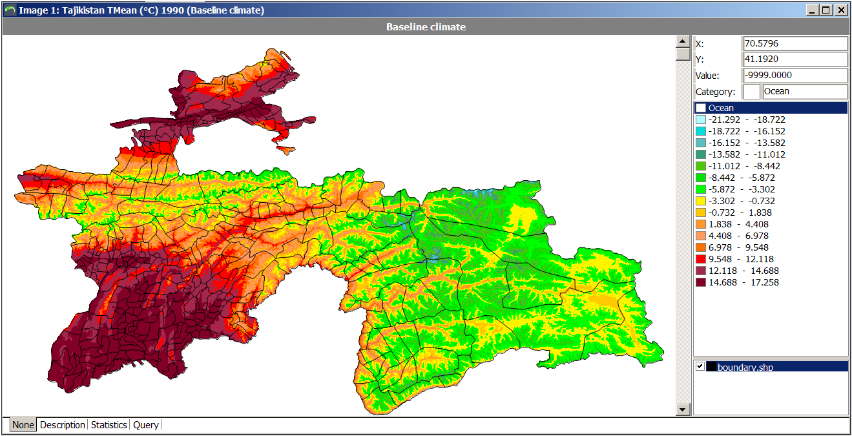
Sample out put from SimCLIM, high resolution climate data

Slide 15
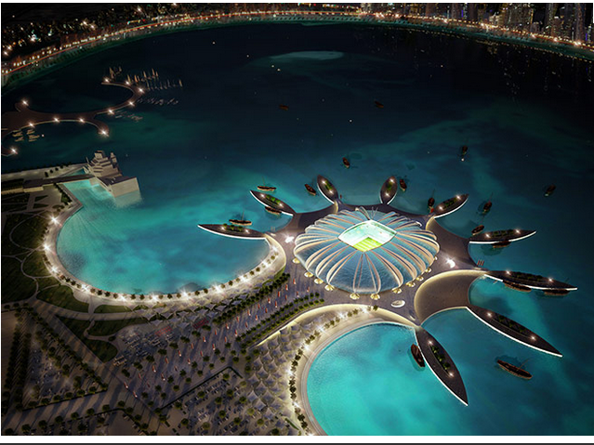
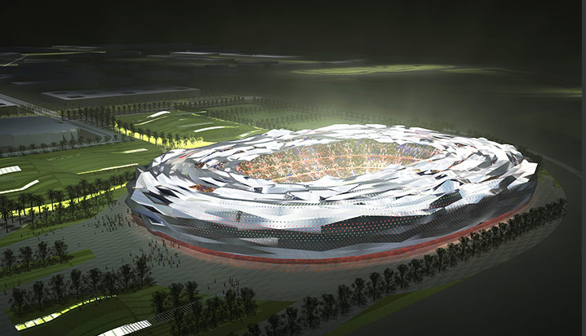
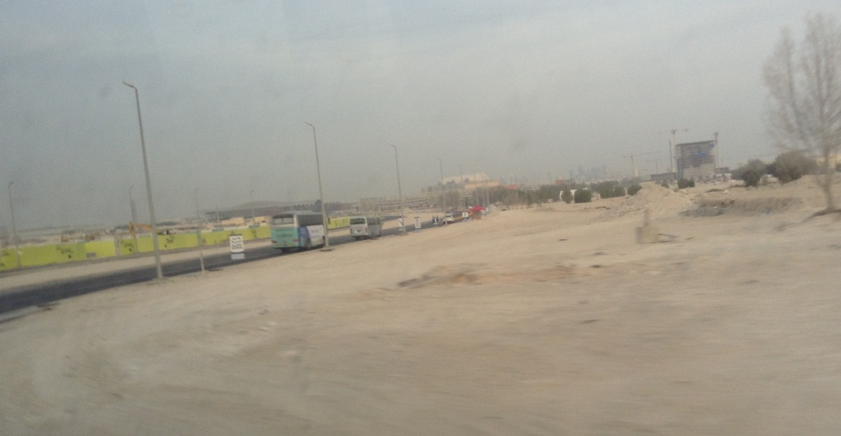
FIFA World Cup 2022 stadium

Slide 16
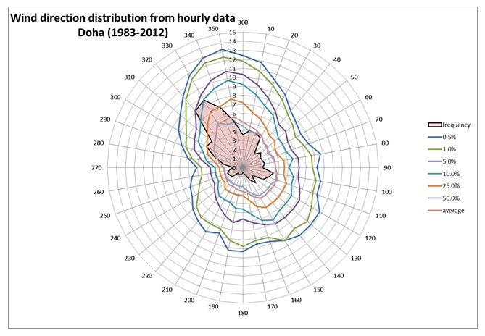
FIFA World Cup 2022

Slide 17
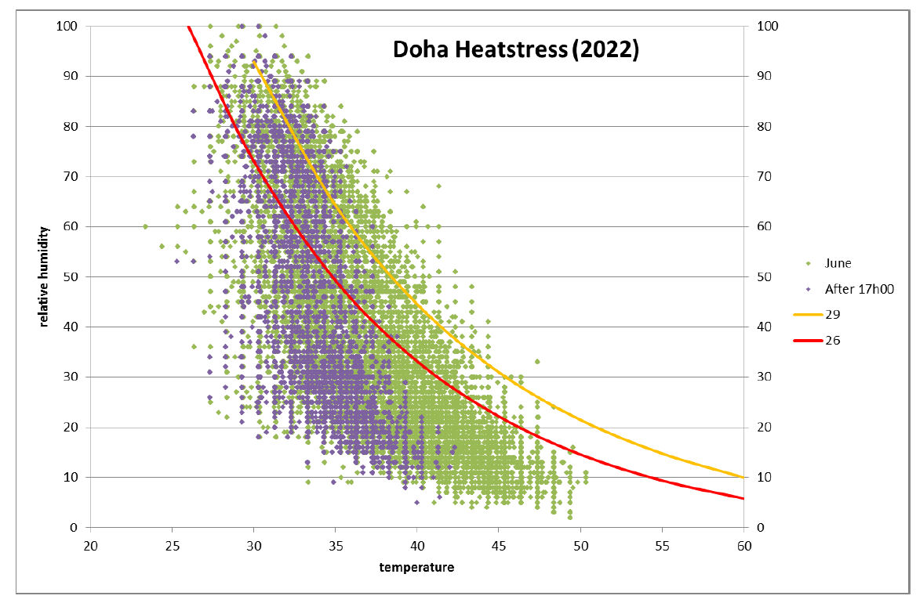
FIFA World Cup 2022

Slide 18
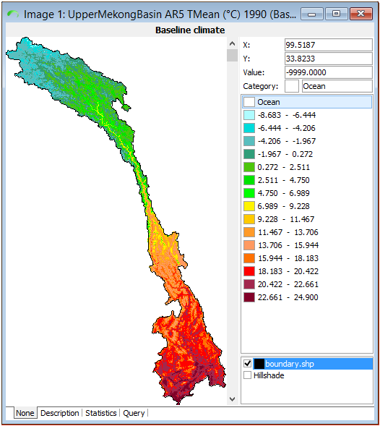
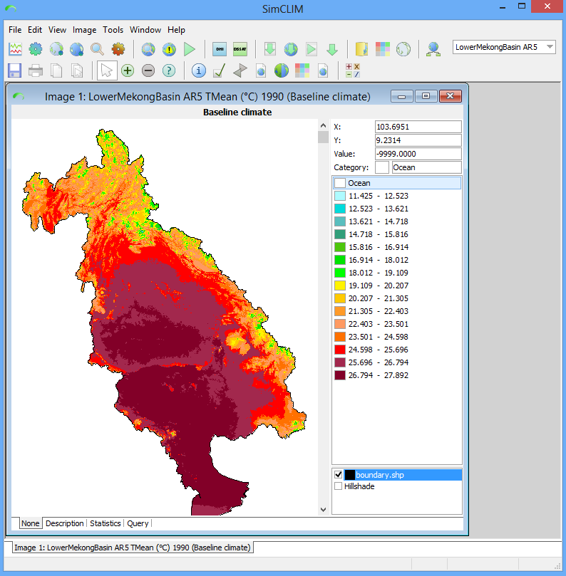
MRC climate change data
All GCM data from CMIP3 (21) and CMIP5(40) scaling data in an ArcGIS compatible format
With Visualization tool
Ensemble analysis functions
Extract data for sub-basins
Change factors for SWAT
Station data verification and management

Slide 19



SimCLIM and GENIES/ UrbanCLIM
Direct User
involvement
Focusing on urban area planning
Generic impact models/tools
Risk assessment
Enabling Decision making support
Climate change and sea level scenarios
Climate change data library
Specific impact tools built by end users
Adaptation social economic analysis

Slide 20
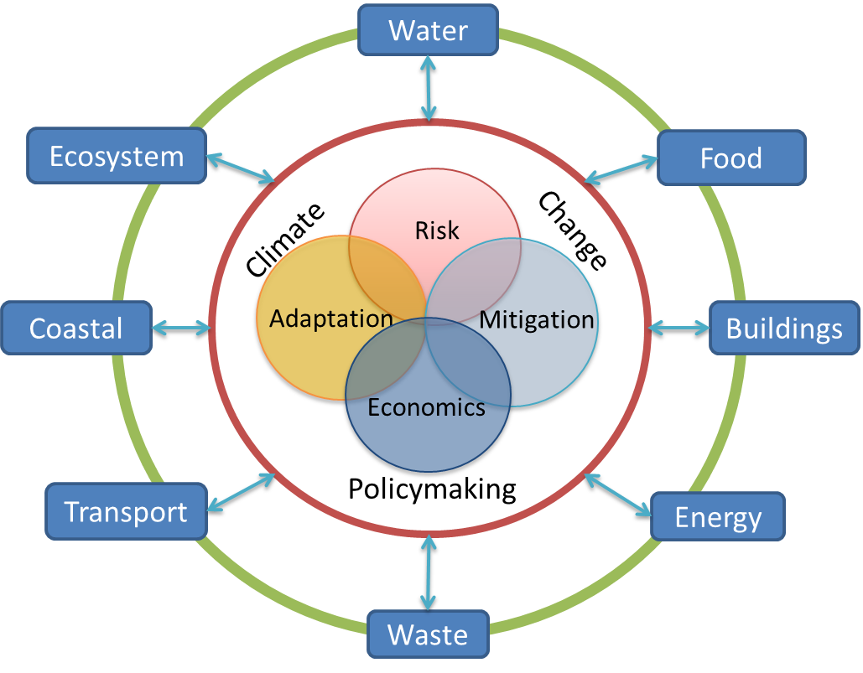
GENIES sectoral interaction in relation to climate change
Climate change issues are central
Risk, adaptation, mitigation and economics are core issues
In the context of urban planning and policymaking
All sectors link to climate change issues
(each sector has a long list of risks and opportunities)
Sectors interact by nature
(can be complicated)
Philosophy 1: Out of clutter, find simplicity

Slide 21
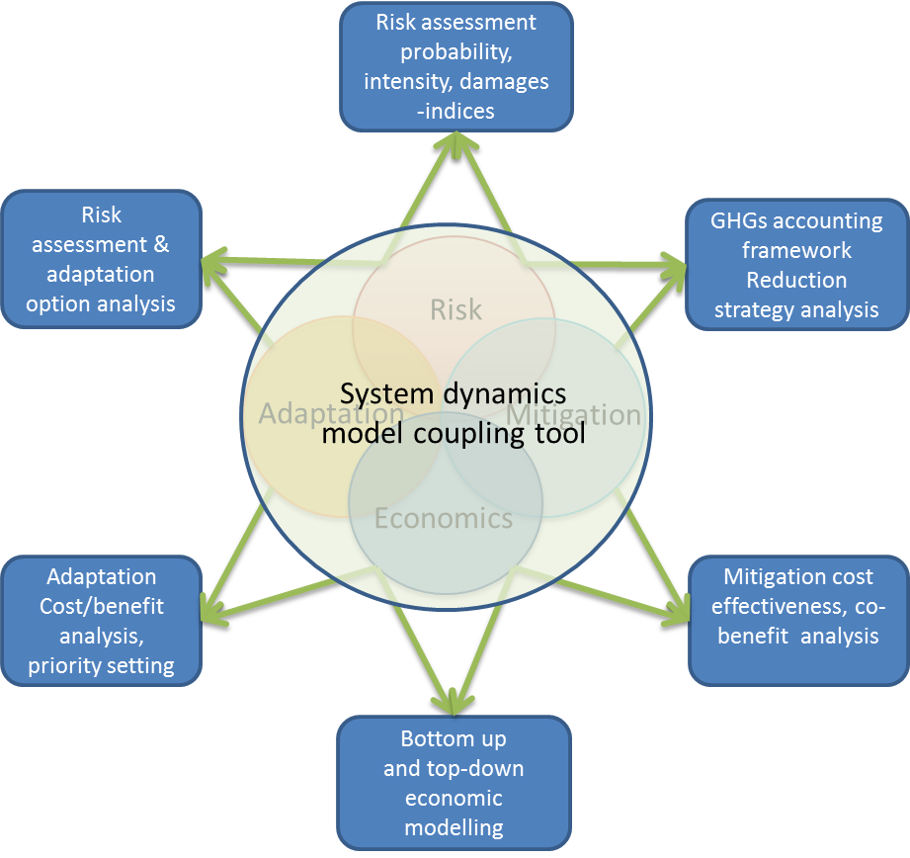
Modelling methodological structure
Impact assessment modelling
and coupling tools
Models must be coupled and developed using an integrated model and system dynamics methodologies.
(Model registry, data exchange, workflow definition)

Slide 22
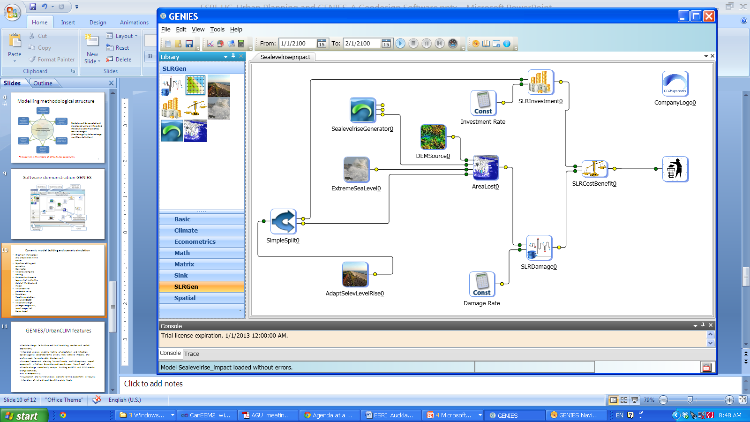
Dynamic model building and scenario simulation based on system dynamics engine
Drag from the toolbox and drop blocks in the canvas
Equation editing and compiling
Connector
Model building and revising
Block and sub-model logos which link to the detail of the block and model
Model control parameter setup
Simulation
Results visualization, plot and 2D
Model skin design (change background, insert images, text boxes, logos)

Slide 23
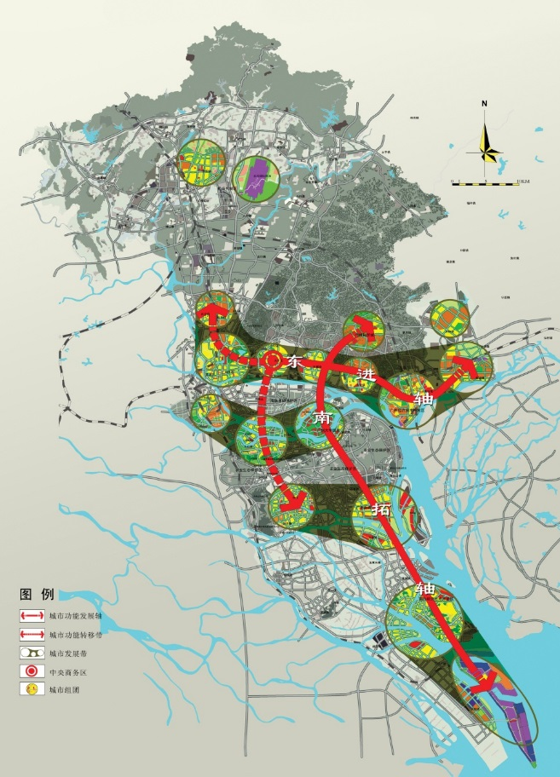
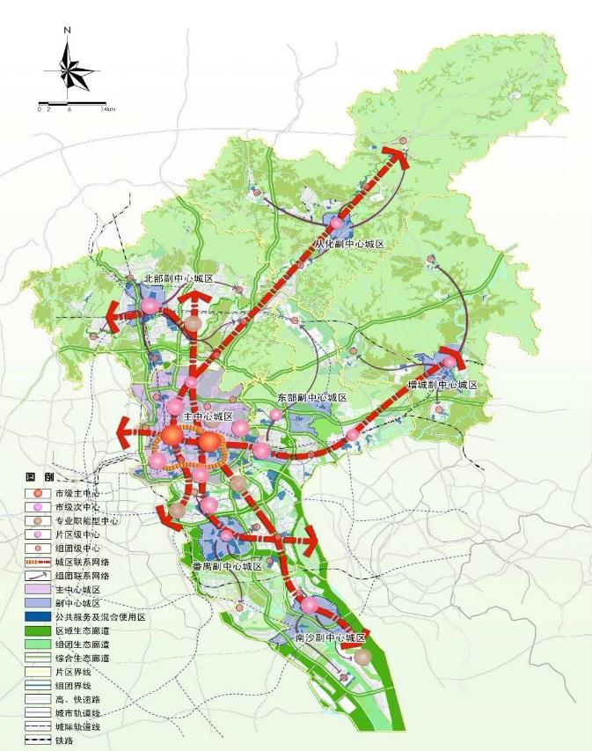
Guangzhou urban development master plan
East and South are major directions for development
Spatial strategy: Expanding South, Optimising North, Developing East, Combining West
Guangzhou has been always the hub and commercial centre regionally due to the unique location for good port
the city expanded along the river down stream
Since trade has been playing critical role in Guangzhou's economy, port has been indispensable part of the city for centuries
the relationship between the city and the water is the essential topic for planners

Slide 24
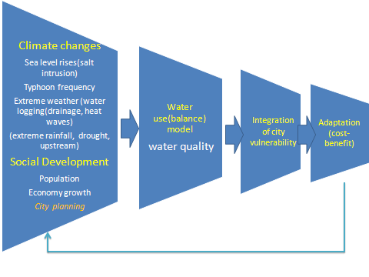
Water resources management

Slide 25
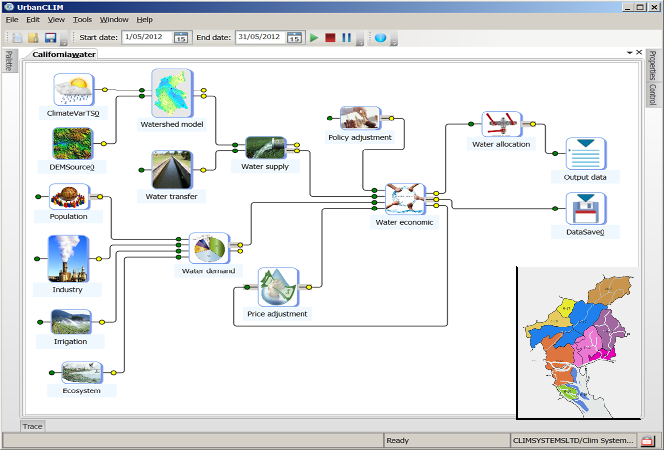
Water management concept model

Slide 26
Process for GENIES/UrbanCLIM application
Data availability assessment
Model testing
Story boarding,
Clear of the question and problem identification
Model building:
Data linkage and algorisms
Visualization
Analysis
Model conceptual, modelling feasibility
Scenarios simulation

Slide 27
Thank you

